Slide 1
-PAPER PRESENTATION-
Privacy Preserving OLAP
Rakesh Agrawal - IBM Almaden
Ramakrishnan Srikant - IBM Almaden
Dilys Thomas - Stanford University
CMPE 521
PRINCIPLES of DATABASE SYSTEMS
By ERGUN BAĞCI

Slide 2
CONTENT
Overview of the paper’s subject
Introduction – Privacy preserving computation approach / Basic idea
Related Work Done by Authors
Data Perturbation (Randomization)
Reconstruction and Reconstruction Algorithms
Guarantees against Privacy Breaches (Güvenlik Açıkları)
Extensions
Summary and Future Work
Questions...

Slide 3
OVERVIEW
Briefly, I will present techniques for privacy-preserving computation of multidimensional aggregates on data which is partitioned across
multiple clients.

Slide 4
OVERVIEW
More detail...
Data from different clients is perturbed (randomized) in order to preserve privacy before it is integrated at the server.
Authors develop formal notions of privacy obtained from data perturbation and show that their perturbation provides guarantees against privacy breaches (güvenlik açıkları).
They develop and analyze algorithms for reconstructing counts of subcubes over perturbed data to an estimated answer.
They also evaluate the tradeoff between privacy guarantees and reconstruction accuracy and show the practicality of this approach.

Slide 5
INTRODUCTION
Today, On-line analytical processing (OLAP) is a key technology employed in business-intelligence systems.
The computation of multidimensional aggregates is the essence of on-line analytical processing.
Throughout this presentation, I will present techniques for computing multidimensional count aggregates in a privacy-preserving way.
Note that, all domains in this study are numeric.

Slide 6

INTRODUCTION
Now let’s see the query ran on server S...
The server runs aggregate queries of the form
The basic idea is that every client Ci perturbs its row ri before sending it to the server S .
The randomness used in perturbing the values ensures information-theoretic row-level privacy
S runs queries on the resultant perturbed table T’.

Slide 7
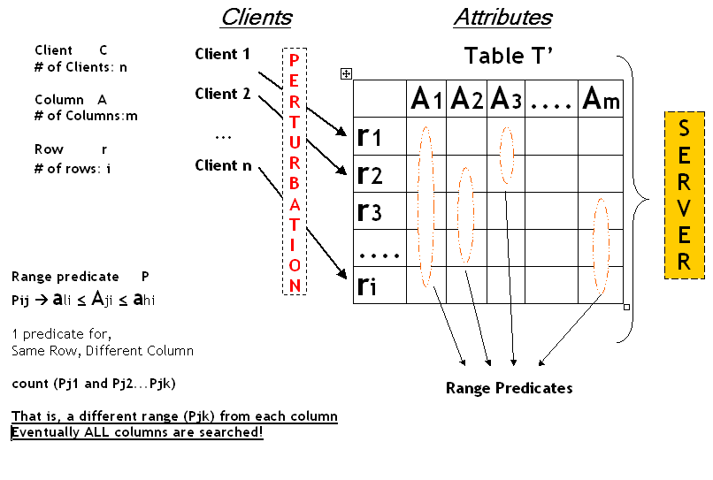

Slide 8
INTRODUCTION
The query meant for the original table T is translated into a set of queries on the perturbed table T’.
The answers to these queries are then reconstructed to obtain the result to the original query with bounded error.
Authors show that their techniques are safe against privacy breaches.

Slide 9
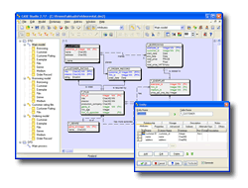
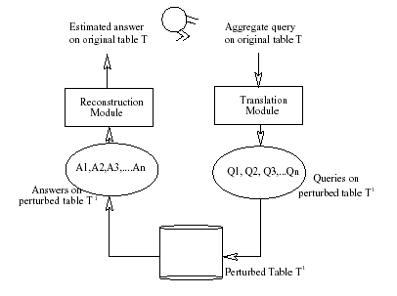
Architecture
Estimated answer!

Slide 10
Now lets go over on some properties of the approach:
The perturbation algorithm is publicly known BUT the actual random numbers used in the perturbation are hidden.
To allow clients to operate independently, local perturbations is used so that the perturbed value of a data element depends only on its initial value and not on those of the other data elements.
Different columns of a row are perturbed independently.
Authors use retention replacement schemes where an element is decided to be retained with probability p or replaced with an element selected from a probability distribution function (p.d.f.)

Slide 11

RELATED WORK
In one study:Slightly different perturbation technique (Additive perturbation) is used with a different p.d.f., that the authors feel difficult to prove its security.
In another: Privacy preserving association rule mining is studied but only on boolean data.
In one other study: A model is built for a single server, unlike our problem where data is integrated from multiple clients.
And... In another related study, model is designed for a small number clients.
A nice contribution of previous literature survey is: Adaptation of Formal definitions of “privacy breaches” in this study from a previous paper...

Slide 12
DATA PERTURBATION
Let’s begin with Definitions...
A single record of the table is referred to as a row, while an attribute is referred to as a column.
A single column from a single row is the granularity of perturbation and is called a data element.

Slide 13
DATA PERTURBATION
DEFINITION 1
Perturbation Algorithm: A perturbation algorithm is a randomized algorithm that given a table T creates a table T’ having the same number of rows and columns.
T : Original table
T’: Perturbed table
Note that, table is perturbated column by column!

Slide 14

DATA PERTURBATION
DEFINITION 2
Retention Replacement Perturbation:
Retention replacement perturbation is a perturbation algorithm, where each element in column j is retained with probability pj, and with probability (1- pj) replaced with an element selected from the replacing p.d.f. (in this study, “Uniform distribution” is used)

Slide 15

Randomization Approach Overview
30 | 70K | ...
50 | 40K | ...
...
Randomizer
Randomizer
65 | 20K | ...
25 | 60K | ...
...
Reconstruct
distribution
of Age
Reconstruct
distribution
of Salary
...
Data Mining
Algorithms
Model

Slide 16
Single Attribute Example
What is the fraction of people in a shoping mall with age between 30 and 50?
Assume age range is between 0-80
Whenever a person enters the building flips a coin of bias p=0.3 for heads say.
  Heads -- report true age
  Tails -- random number uniform in 0-80 reported
Totally 100 randomized numbers collected.
Of these 26 are 30-50.
How many among the original are 30-50?

Slide 17
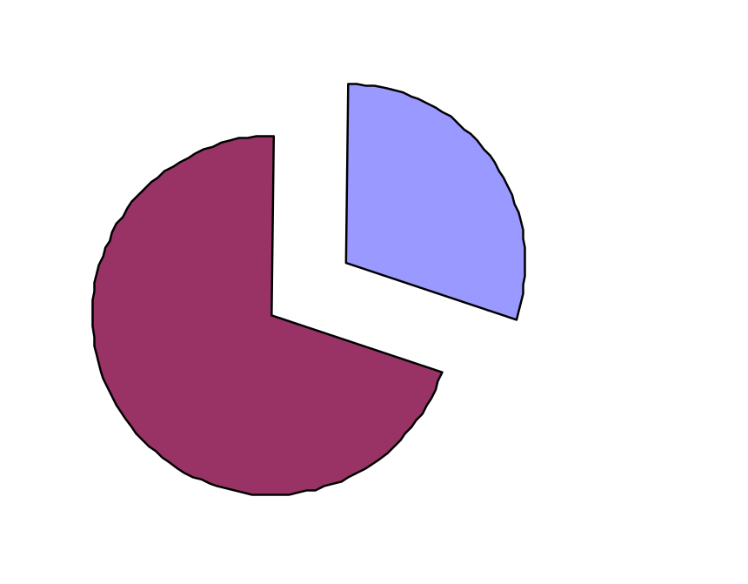
Analysis
30 Retained
70 Perturbed
Out of 100 :
70 perturbed (0.7 fraction), 30 retained (0.3 fraction)

Slide 18
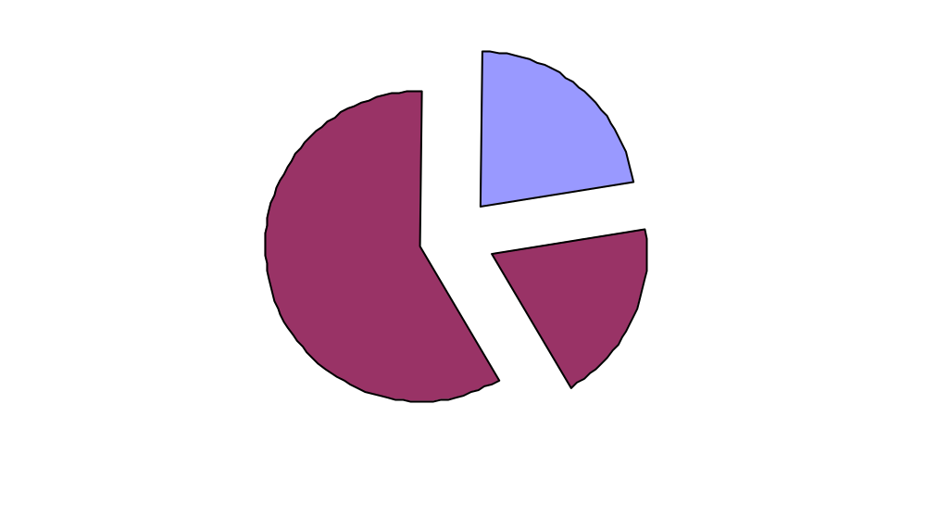
100 samples * Apriori.Prob = 100 * 0.3 = 30.....Retained
100-30 = 70.....Perturbed
80-0 = 80......Range of data
50-30 = 20.....Range of query
(50-30)/(80-0)= 0.25.....Rate of Age[30-50] for uniform p.d.f.
70 * 0.25 = 17,5 ...... Perturbed, Age[30-50]
70 - 17.5 = 52.5 ...... Perturbed, NOT Age[30-50]
30 Retained
52,5
Perturbed ,
NOT Age[30-50]
17,5 Perturbed, Age[30-50]

Slide 19
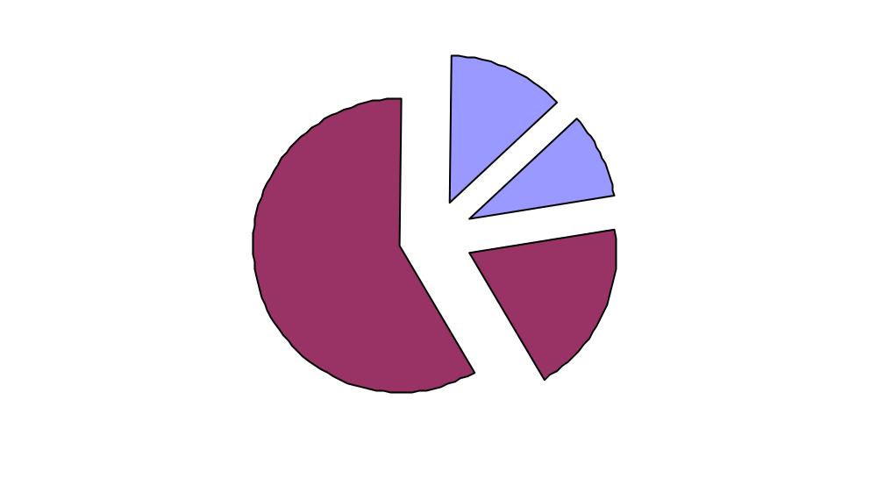
11,5 Retained , NOT Age[30-50]
8,5 Retained, Age[30-50]
52,5 Perturbed,
NOT Age[30-50]
17,5 Perturbed, Age[30-50]
Since there were 26 randomized rows in [30-50]. 26 - 17,5 = 8,5 of them come from the 30 retained rows.

Slide 20
Scaling up
Total Rows | Age[30-50] (Retained)
30 | 8,5
100 | 28,3 (26)
Thus 28,3 people had age 30-50 in expectation.
This gives intuition about how we reconstruct!

Slide 21
RECONSTRUCTION
DEFINITION 3
Reconstructible Function: Given a perturbation ά converting table T to T’ , a numeric function f on T is said to be (n,ε,δ) reconstructible by a function f ' , if f ' can be evaluated on the perturbed table T' so that | f ‘ - f | < max(o, εf ) with probability greater than (1- δ) whenever the table T has more than n rows. The probability is over the random choices made by ά.
İdea is: An aggregate function on the original table T, must be reconstructed by accessing the perturbed table T’ .

Slide 22
RECONSTRUCTION
Result of DEFINITION 3
The accuracy of the reconstruction algorithm is formalized by the notion of approximate probabilistic reconstructability.
At the end, 2^{k} number of queries formed, where k is the number of columns/range predicates, in the form of:
count(P1 .P2 .. . . Pk), count(¬P1 .P2 .. . . Pk), count(P1 .¬P2 .. . . Pk), count(¬P1.¬P2.. . . Pk) . . . count(¬P1.¬P2.. . . ¬Pk)
These queries are evaluated on the perturbed table .
The answers on T’ are reconstructed into estimated answers for the same queries on T, which include the answer to the original query.

Slide 23
Reconstruction Problem
Original values x₁, x₂, ..., x_{n}
  from probability distribution X (unknown)
To hide these values, we use y₁, y₂, ..., y_{n}
  from probability distribution Y
Given
  x₁+y₁, x₂+y₂, ..., x_{n}+y_{n}
  the probability distribution of Y
Estimate the probability distribution of X.

Slide 24
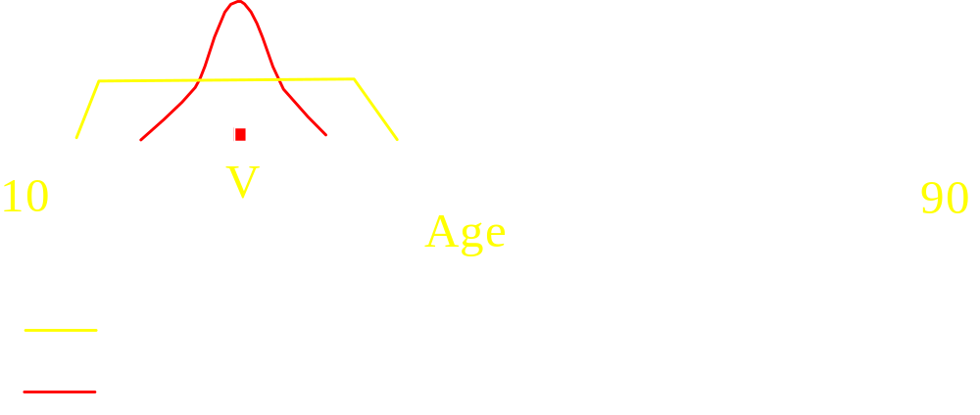
Intuition (Reconstruct single point)
Use Bayes' rule for density functions

Slide 25
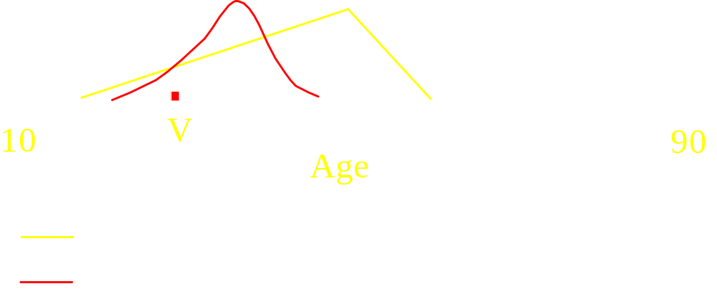
Intuition (Reconstruct single point)
Use Bayes' rule for density functions

Slide 26
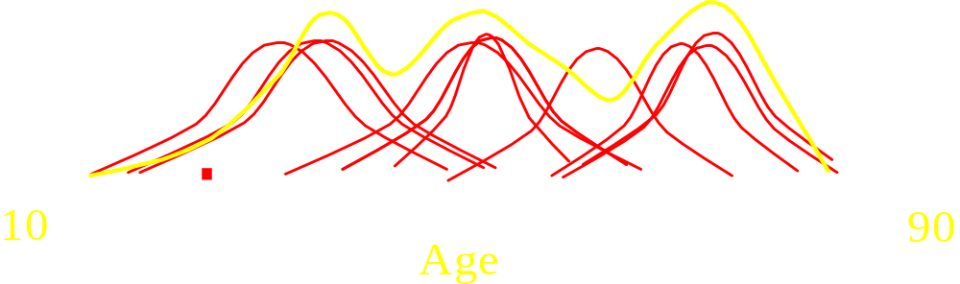
Reconstructing the Distribution
Combine estimates of where point came from for all the points:
  Gives estimate of original distribution.

Slide 27

Reconstructing Single Column Aggregates
Consider the uniform retention replacement perturbation with retention probability p applied on a database with n rows and a single column, C, with domain [min, max]. Consider the predicate P = C[low, high]. Given the perturbed table T’ , lets see how to estimate an answer to the query count(P) on T. Let tables T, T’ each have n rows. Let nr = count(P) evaluated on table T’ , while no = count(P) estimated for table T. Given nr we estimate no as:

Slide 28

Reconstructing Single Column Aggregates
# of perturbated OR non-perturbed rows, BUT in the range
no nr
estimation!
# of perturbated rows in the range
To scale
Probability of being in the range
# of perturbated rows
Can be used as MLE(Maximum Likelihood Estimator)
and as a good reconstructor

Slide 29

Reconstructing Single Column Aggregates
Here, a theorem is given
According to this, an estimator “x” is given as:
where A is a transition matrix to reconstruct...

Slide 30
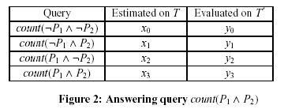
Reconstructing Multiple Column Aggregates
Basic idea...
For multiple column, reconstruction is similar, but, in multiple case
  k X 2 transition matrix is formed
  2^{k} aggregate queries are run on perturbed table
A simple example:

Slide 31
Reconstruction Multiple Column Aggregates
Two main techniques are used:
  Matrix transition technique
  If pr is the retention probability for the rth column, we calculate vector x from vector y as x = yA-1. The transition matrix A, which is with 2^{k} rows and 2^{k} columns, can be calculated as the tensor product of matrices
  where the matrix Ar, for 1 < r < k is the transition matrix for column r.
Briefly, the idea is to form a transition matrix for each COLUMN.
With tensor product of matrices, matrix A is formed.
So, we have split the space of possible evaluations of a ROW into 2^{k} states.

Slide 32
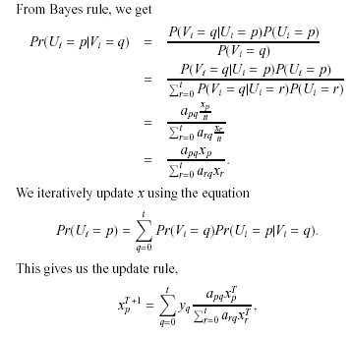
  Iterative bayesian technique
Basic idea is:
Initializing the vector, x0 = y, and iterating until two consecutive
x iterates do not differ much.

Slide 33
Errors in Reconstruction
Due to the randomization in the perturbation algorithm there are errors in the transition probabilities in matrix A. This causes y, the posteriori distribution after perturbation calculated from T’ , to have errors. Hence the reconstructed x will have errors.
  The error decreases as the number of rows, n, increases.
  The error in reconstruction increases as the number of reconstructed columns, k, increases, and the probability of retention, p, decreases.

Slide 34
Guarantees Against Privacy Breaches
Two types of privacy breaches are mentioned:
1.
2.

Slide 35
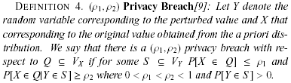
(ρ1, ρ2) privacy breach
It means,If original (a priori) probability of a condition is smaller or equal to ρ1 and perturbated probaility (posteriori) is greater or equal to ρ2, there is (ρ1, ρ2) privacy breach...
This breach is referred to another paper and no any quantitative value is given in both, as the measure of the breach.

Slide 36
(s, ρ1, ρ2) privacy breach
Second one is the extended version of the first formed by the authors.
They considered a database of purchases made by individuals.
They think that: Many people buy bread, but not many buy the same prescription medicine.
Attention!
The new metric is more concerned about whether an adversary can infer from the randomized row which medicine a person bought, and is less concerned about the adversary determining with high probability that the original row had bread, as most individuals buy bread and it does not distinguish the individual from the rest of the crowd.

Slide 37

Guarantees Against Privacy Breaches – A security condition!
Single Column Perturbation (Theorem)
Let p be the probability of retention, then uniform perturbation applied to a single column is secure against a (s, ρ1, ρ2) breach, if
Where s is equal to ps/ms.
  ps is a priori probablity (p(age<10)=0.2)
  ms is replacing probablity of p.d.f. used
For Multiple column perturbation, idea is same but calculation is more complicated...

Slide 38

Theorem for s value

Slide 39
EXTENSIONS
Three different types of extensions can be made :
  Papers approach can be directly applied on Categorical data
  Alternative retention replacement schemes can be formed
  Approach can be extended to classification

Slide 40

Categorical data
For categorical data, extension of algorithms are extremely simple:
Define: Consider a categorical column, C, having discrete domain D. Let . A predicate P, on column C, using S is defined as
Use: Use this as retention replacement probability

Slide 41
Alternative retention replacement schemes
1.Identity Perturbation:
Data element is replaced by a random element selected uniformly among all data elements (i.e. The replacing p.d.f. is the same as the a priori distribution).
2.Swapping:
Numbers decided to be replaced are randomly permuted amongst themselves.

Slide 42
Application to Classification
Aggregate queries on multiple columns can be used for privacy preserving construction of decision trees.
Example:A decision tree is built on randomized table T’ with schema (age, salary, house-rent, class-variable) to predict the column class variable.
Here, idea is : For the first split, say on (age < 30), the gini index is calculated using the estimated answers of the four queries: count(age[0-30] and ¬Q), count(¬age[0,30] and ¬Q), count(age[0-30] and Q ) and count(¬age[0,30] and Q ) on T.

Slide 43
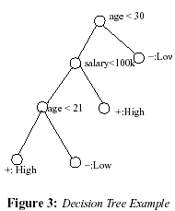

Slide 44

EXPERIMENTS
Both real data and synthetic data is used
For real data, authors used the Adult dataset, from the UCI Machine Learning Repository.
Dataset contains about 32,000 rows with 4 numerical columns. (The columns and their ranges are: age[17 - 90], fnlwgt[10000 - 1500000], hrsweek[1 - 100] and edunum[1 - 16].)
For synthetic data, authors used uncorrelated columns of data having Zipfian distribution with zipf parameter 0.5.

Slide 45
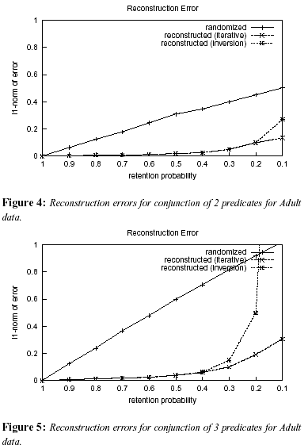
Randomization and Reconstruction Experiments
The l1 norm of the difference between the estimated (x) and actual (x' ) p.d.f. vectors is used as the metric of error.
The results of the reconstruction algorithm are said to be quite accurate when the reconstruction error is much smaller than 1.
The iterative procedure gives smaller errors than the inversion procedure, especially when a larger number of columns are reconstructed together, and the probability of retention, p, is small.

Slide 46
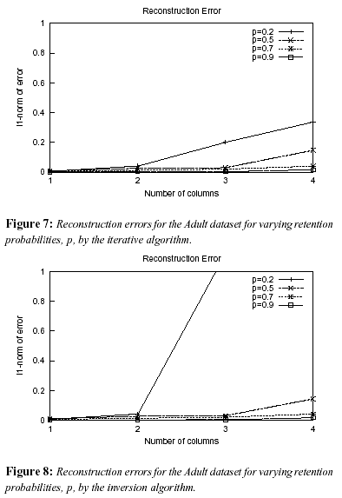
Scalibility Experiments
Now lets see, how the reconstruction error varies as the number of columns reconstructed, retention probability AND number of rows vary.
Both iterative and inversion algorithms show an exponential increase in the error as the number of columns increases and as the probability of retention decreases. For smaller number of columns and higher retention probabilities both algorithms give comparable reconstruction errors.

Slide 47
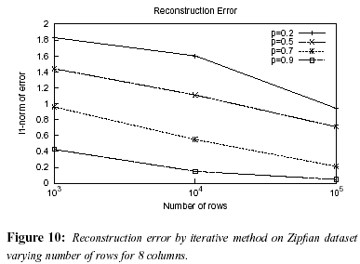
Number of rows in the table
Reconstruction error decreases as the number of perturbed rows available for reconstruction increase, for the the iterative reconstruction algorithm.

Slide 48
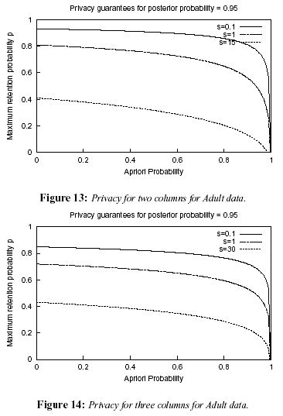
Privacy Breaches
The two figures plot the maximum retention probability, p, that would avoid a (s, ρ1, ρ2) breach. See y axis.
The values of s used are the maximum value of s, the median value s = 1, and s = 0.1 for a rare set (because of a theorem given in the paper).
Both figures show that if it suffices to just hide rare properties (i.e., with s < 0.1),even the the retention probability p is as high as 0.8.

Slide 49
CONTRIBUTIONS and FUTURE WORK OF THE PAPER
  Problem is introduced for a distributed environment.
  It introduces the formalism for reconstructible functions on a perturbed table, and develop algorithms to reconstruct multiple columns together.
  Two reconstruction algorithms are introduced. These algorithms can reconstruct count aggregates over subcubes without assuming independence between columns.
  It evaluates proposed reconstruction algorithms both analytically and empirically.
  It shows the use of techniques to related applications like classification.
Future work includes extending this work to other aggregates over subcubes (Not only count aggregates).

Slide 50
CONCLUSION
A good paper with experimental results, the approach and results are interesting
Compared to previous related works, it takes into account more features for consideration
BUT, In some sections more explanation is needed.

Slide 51

QUESTIONS ?

Slide 52
As a concrete example, for uniform perturbation, with p=0.2, there are no
(68, 0.1, 0.95) breaches. This means for any set S ,
if ρ2 > 0.95 with uniform perturbation,
ρ1 will be large (> 0.1) when ps/ms < 68.
In fact, for a rare set, with s < 1, there will be no (0.937, 0.95) privacy breaches in the original (ρ1, ρ2) model for this perturbation.

Slide 53
Back-up slides

Slide 54
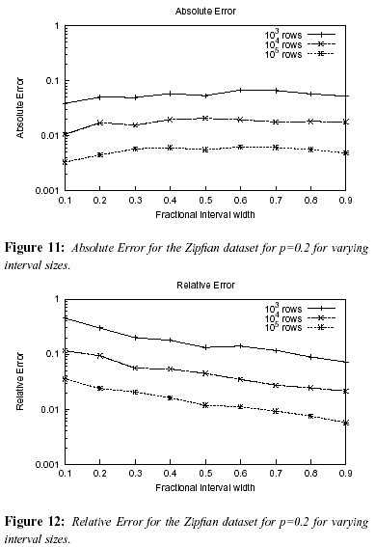
Selectivity of predicates
(e-a) -> absolute error
(e-a)/a -> relative error
The absolute error in Figure 11 does not vary much with the interval width. However the relative error in Figure 12 increases as the interval width decreases.
Both the absolute and relative errors decrease as the number of rows available for reconstruction increases.

